Slide 1
MIS Reporting including
Pre-Poll/Poll Day/Post Poll Reports

Slide 2
Pre-Poll Reports – Nomination Related

Slide 3
Statutory Reports on Nomination
Sl. No. | Type of Form | No. of sets to be submitted | Reporting Days | Time of Reporting | Mode of Reporting
 | Form 3A(Notice of Nomination) | 01 set separately in English and Bengali version | Every day from the date of issue of notification to the last date of filing of nomination | 3.30 p.m. | Signed hard copy through e-mail to CEO’s office.
2. | List of Nominated Candidates (consolidated) | 01 set separately in English and Bengali version | On the last date of filing nominations | 3.30 p.m. | Signed hard copy through e-mail to CEO’s office.
 |  | 03 set separately in English and Bengali version along with signature and seal of R.O’s | On the very next day of the last date of filing nominations | 11.00 a.m. | Through Special Messenger

Slide 4
Sl. No. | Type of Form | No. of sets to be submitted | Reporting Days | Time of Reporting | Mode of Reporting
3. | List of validly Nominated Candidates in FORM-4 | 01 set separately in English and Bengali version | On the day of scrutiny of nominations | Immediately after completion of scrutiny | Signed hard copy through e-mail to CEO’s office.
 |  | 03 set separately in English and Bengali version along with signature and seal of R.O’s | One the very next day of the day of scrutiny of nominations | 11.00 a.m. | Through Special Messenger

Slide 5
Sl. No. | Type of Form | No. of sets to be submitted | Reporting Days | Time of Reporting | Mode of Reporting
4. | List of Contesting Candidates in FORM 7A | 01 set separately in English and Bengali version | On the day of withdrawal of candidature | 3.30 p.m. | 1. Signed hard copy through e-mail to CEO’s office.
 |  | 03 set separately in English and Bengali version along with signature and seal of R.O’s | On the very next day of withdrawal of candidature | 11.00 a.m. | Through Special Messenger

Slide 6
Non-Statutory Reports on Nomination
Election Commission of India calls for certain reports every day during the entire period of filing of nomination. Accordingly the following non-statutory reports are to be submitted:
Filing of Nominations (Format-I)
Validly Nominated Candidates (Format-II)
Report on withdrawal of candidature and final party wise candidature(Format-III)
The respective reports are to be sent every day during the entire period of nomination by 3.30 P.M.

Slide 10
REPORTS ON THE DATE OF DISPERSAL OF POLLING PARTIES (P-1 day)

Slide 11
Sl | Subject | Reporting Time | Form of reporting | Syntax for SMS | Remarks
1 | Total no. of Polling Parties taken delivery of materials at DC | Hourly report from 1000 Hrs till delivery to final party | SMS / WhatsApp | MD056% | MD stands for materials delivered at DC and 056 stands for % of PPs to whom materials delivered at DC.
2 | Total no of EVMs replaced on the date of dispersal of Polling Parties | Hourly report from 1000 Hrs till delivery to final party | SMS / WhatsApp | EVMR016 | EVMR stands for EVM replaced at DC and 016 stands for no. of EVMs replaced at DC.
2a | Total no of VVPATs replaced on the date of dispersal of Polling Parties | Hourly report from 1000 Hrs till delivery to final party | SMS / WhatsApp | VVPATR018 | VVPATR stands for VVPAT replaced at DC and 018 stands for no. of VVPATs replaced at DC.
3 | No of Polling Parties safely reached Polling Station | Hourly report from 1300 Hrs till final party reaches | SMS / WhatsApp | SAP056% | SAP stands for safe arrival of PPs at PSs and 056 stands for %. of PPs arrived safely at their PS.
 |  | Final Report (Scanned copy under signature of DEO) | E-mail | _ | _

Slide 12
REPORTS ON THE DATE OF POLL: (P-day)

Slide 13
Sl | Subject | Reporting Time | Form of reporting | Syntax for SMS | Remarks
1 | Total no. of Polling Stations where Mock Poll has started | 10 minutes interval report from 0615 Hrs till it has started in all the Polling Stations | SMS / WhatsApp | MPS056% | MPS stands for Mock Poll started and 056 stands for % of PS where mock poll has started.
2 | Total no. of Polling Station where Poll has started after completion of Mock Poll | 10 minutes interval report from 0700 Hrs till poll has started in all the Polling Stations | SMS / WhatsApp | PS056% | PS stands for Poll started after completion of mock poll and 056 stands for % of PS where poll has started after mock poll.
 |  | Final Report at 0730 Hrs (Scanned copy under signature of DEO) | email | _ | _
3 | Total no of EVMs and VVPATs replaced at DC and at Polling Station till the time before commencement of Poll | Final Report at 0730 Hrs (Excel sheet and Scanned copy under signature of DEO) | email | _ | _

Slide 14
Sl | Subject | Reporting Time | Form of reporting | Syntax for SMS | Remarks
4 | Facts at a Glance Report | 2 Hourly report from 0900 Hrs to close of Poll | email | _ | _
5 | % of POLL | 2 Hourly report from 0900 Hrs | SMS / WhatsApp | P26% | P stands for Poll and 26 stands for cumulative % of poll till that time in all the ACs of the district
 |  |  | SMS/ WhatsApp and Email | _ | _
 |  | Final Report at Close of Poll | email | _ | _

Slide 15
Sl | Subject | Reporting Time | Form of reporting | Syntax for SMS | Remarks
6 | Report regarding Poll Boycott | Hourly report from 0800 Hrs | SMS / WhatsApp | _ | _
7 | Report regarding any major incident and arrest including vitiation of poll | Hourly report from 0800 Hrs | SMS / WhatsApp | _ | _
8 | Total no of EVMs-VVPATs replaced at Polling Station after commencement of Poll | Hourly report from 0700 Hrs till close of poll | SMS/ WhatsApp/ E-mail | _ | _
 |  | Final Report at 1630 Hrs | email | _ | _

Slide 16
Sl. | Subject | Reporting Time | Form of reporting | Syntax for SMS | Remarks
9 | ROs' reports in Annexure--41 | 1st Report at 1300 Hrs | email | _ | _
 |  | 2nd Report at 1900 Hrs | email | _ | _
10 | ROs' reports in Annexure--40--A/B/C wherever situation so demands | Final Report at 1900 Hrs | email | _ | _
11 | No. of Polling Parties reported RC | Hourly report from 1800 Hrs till final party reaches | SMS / WhatsApp | SARC112 | SARC stands for Safe Arrival at R.C. and 112 means no. of Polling Parties reached RC
 |  | Final Report | email | _ | _

Slide 17
FACTS AT A GLANCE
Date of Poll:
Date of Report :
Sl No. | Issues | Status
1 | Number of Parliamentary Constituencies going to poll
2 | No of Districts involved
3 | No of Assembly Segment involved
3 | General Electors | Total
 |  | Male
 |  | Female
 |  | Third Gender
4 | Service Electors | Total
 |  | Male
 |  | Female
 |  | Third Gender
5 | Overseas Electors
6 | Total No. of Electors including Service Electors | Total
 |  | Male
 |  | Female
 |  | Third Gender
7 | Total number of candidates | Total
 |  | Male
 |  | Female
 |  | Third Gender
8 | No. of Polling Stations | Total
 |  | Main
 |  | Auxiliary
9 | No. of Polling Station Locations
10 | No. of Critical Polling Stations/Locations in the Constituencies | No. of critical polling stations
 |  | No. of critical polling station locations
11 | Percentage of Electors issued with EPIC
12 | Percentage of PER

Slide 18
FACTS AT A GLANCE
13 | (a) No. of EVMs-VVPATs to be used | Control Units -
 |  | Ballot Units -
 |  | VVPAT
 | (b)Reserve EVM- VVPAT | Control Units -
 |  | Ballot Units -
 |  | VVPAT
 | Total | Control Units -
 |  | Ballot Units -
 |  | VVPAT
14 | Total No. of Women Candidates –
15 | Party-wise list of candidates (Number) | Name of Political Parties
 |  | A. Recognized National & State Political Parties
 |  | 1.BSP
 |  | 2.BJP
 |  | 3.CPI
 |  | 4.CPI(M)
 |  | 5.INC
 |  | 6.NCP
 |  | 7.AIFB
 |  | 8.AITC
 |  | 9. RSP
 |  | Total
 |  | B. Registered Political Parties (other than recognized National and State Political Parties)
 |  | C. Independents
 |  | Total
16 | No. of EVMs-VVPAT replaced during Mock Poll | CU
 |  | BU
 |  | VVPAT
17 | No. of EVMs-VVPAT replaced during Poll [cumulative figure] | CU
 |  | BU
 |  | VVPAT
18 | Total No. of ECI Observers | General Observers –
 |  | Expenditure Observers –
 |  | Police Observers –
 |  | Awareness Observers -
19 | Micro Observers deployed
20 | Total no. of Polling Personnel deployed -Civil

Slide 19
FACTS AT A GLANCE
21 | Total no. of Polling Personnel deployed - Police
22 | Helicopters to be used (if any)
23 | Total no. of Force deployed | CPF (coy)
 |  | State Police Officer
 |  | Constable
 |  | Total State Force
24 | Total no. of Digital (Still Photography) Cameras deployed
25 | Total no. of Video Cameras deployed
26 | Total no. of CCTV /offline webcasting
27 | Total polling stations where Webcasting done
28 | LMSA Vehicle
29 | Total no. of licensed arms (District Figure)
30 | No. of arms deposited (District Figure)
31 | No. of NBWs against accused persons executed after announcement of election (District Figure)
32 | No. of bonds taken under section 107 Cr.P.C. (District Figure)
33 | Poll Boycott, If any (At the time of Reporting) | Booth no.
 |  | Reason for Boycott
34 | Major Incidents (At Reporting time) | Description
 |  | Action Taken

Slide 20
FACTS AT A GLANCE
35 | No. of Arrests (At Reporting time) | A – Political Functionary
 |  | B – Preventive Arrests
36 | Comparative Voters Turn Out in percentage (At Reporting time) | Lok Sabha G.E. 2014
 |  | Assembly G.E. 2016
 |  | Bye Election 2018
37 | Interruption or obstruction of Poll due to riots, open violence, natural calamity or any other cause.
38 | Any incident of booth capturing reported or poll vitiation (at the time of reporting)
39 | Votes having been unlawfully recorded by any person in the EVMs.
40 | Serious complaints from candidates/ voters/political parties and action taken
41 | Violence and breach of law and order
42 | Mistakes and irregularities, which have a bearing on the elections
43 | Weather conditions
44 | Any interesting facts to be shared with the Press
45 | Deaths related to Electors(On the date of Poll)
46 | Seizure of cash in Rupees (On the date of Poll)
47 | Seizure of Arms and Ammunition(On the date of Poll)
48 | Seizure of Liquor(On the date of Poll)
49 | Two hourly poll day Police report is enclosed/will follow

Slide 21
ANNEXURE –41
(CHAPTER XIII, PARA –13.62.1) Handbook for RO, 2016
PROFORMA FOR SUBMISSION OF THE REPORTS TO THE COMMISSION
ON THE DAY OF POLLING
Name of State ..........................
Name of Constituency ......................................
Time of Report ..............................................................
1. Interruption or obstruction of poll due to riots, open violence, natural calamity or any other cause. ………………………………….
2. Vitiation of the poll by any of the EVMs having been unlawfully taken out of the custody of the Presiding Officer, accidentally or unintentionally lost or destroyed or damaged or tampered with. ………………………………………………
3. Votes having been unlawfully recorded by any person in the EVMs. ……………….
4. Booth capturing. ……………………………………………….
5. Serious complaints. ……………………………………….
6. Violence and breach of law and order. …………………………………….

Slide 22
ANNEXURE –41
(CHAPTER XIII, PARA –13.62.1) Handbook for RO, 2016
PROFORMA FOR SUBMISSION OF THE REPORTS TO THE COMMISSION
ON THE DAY OF POLLING
7. Mistakes and irregularities, which have a bearing on the elections. ………………………..
8. Weather conditions. …………………………..
9. Poll percentage. …………………………………………..
10. Whether all the diaries of Presiding Officers have been scrutinized and irregularities, if any detected. …………………………..
11. Recommendations regarding repoll / fresh poll, if any. ………………………….
12. Any other remarks. …………………………………………………………………..
Place ....................................
Date ..................................... Signature of Returning Officer

Slide 23
REPORTS ON THE DATE OF SCRUTINY OF REGISTER 17A ( THE FOLLOWING DAY OF THE DATE OF POLL ) : (P+1 day)

Slide 24
Sl | Subject | Reporting Time | Form of reporting
1 | ROs' reports in Annexure--41 | Final Report at 0700 Hrs | email
2 | Consolidated bunch of all ROs' reports in A05/P05 | Full Report at 0700 Hrs | email
3 | REPORT on Scrutiny undertaken by Observers in the district | Full Report by 1300 Hrs | email
4 | REPORT IN ANNEX-40 A/B/C U/S 57 OF RP ACT, 1951 (IF SITUATION SO DEMANDS), ALONG WITH DETAILED REPORT OF RO & DEO | PRIMARY REPORT ON P DAY & FULL REPORT BY 1300 HRS. ON DAY OF SCRUTINY | email

Slide 25
ECI Form ID |  | Election Commission of India |  |  |  |  |  |  |  |  |  | IMPORTANT
PS05 |  | Bye Elections to the House of the People |  |  |  |  |  |  |  |  |  | NOT TO BE SENT TO THE COMMISSION
VOTER TURNOUT REPORT FOR POLLING STATION
A) | State / UT Name |  |  |  |  |  | B) | Parliamentary Constituency No. & Name
C) | Assembly Segment No. & Name |  |  |  |  |  | d) | Polling Station No. & Name
1. | Date of Poll
2. | Total Electors |  |  |  |  |  | Men
 |  |  |  |  |  |  | Women
 |  |  |  |  |  |  | Third Gender
 |  |  |  |  |  |  | Total
3. | No. of electors who voted (as per item 11 of Presiding Officer's Diary) |  |  |  |  |  | Men
 |  |  |  |  |  |  | Women
 |  |  |  |  |  |  | Third Gender
 |  |  |  |  |  |  | Total
4. | No. of voters identified using EPIC (as per Register of Voters)

Slide 26
ECI Form ID |  | Election Commission of India |  |  |  |  |  |  |  |  |  | IMPORTANT
PS05 |  | Bye Elections to the House of the People |  |  |  |  |  |  |  |  |  | NOT TO BE SENT TO THE COMMISSION
5. | No. of Tendered Votes (as per item 16 of Presiding Officer's Diary)
6. | No. of Declarations submitted under 49 MA
I authenticate the data given above.
 |  |  |  |  |  |  |  | (Presiding Officers' Signature)
For use in Collection Centre
Date & Time of receipt at the collection centre
Signature of Officer-in Charge of Collection Centre
 | Note : | The RO has to make an arrangement for a suitable counter at Collection Centres when each polling party will first hand over this form before the EVMs received. Data from this format will be transcribed to Form A05. A copy of the Data in Form A05 will be handed over to the Observers.

Slide 35
Online Reports at ECI Portal

Slide 36
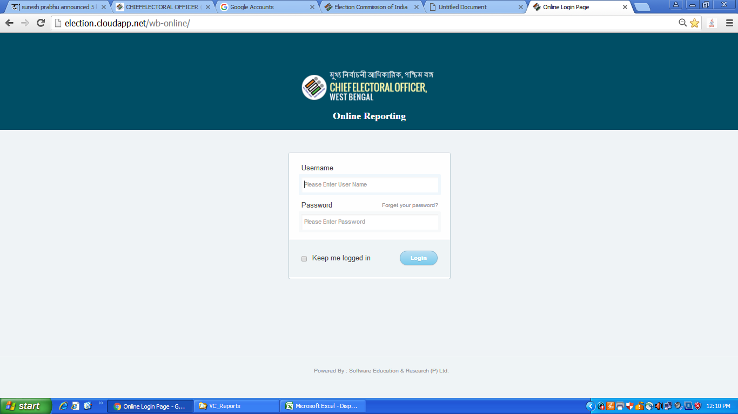

Slide 37
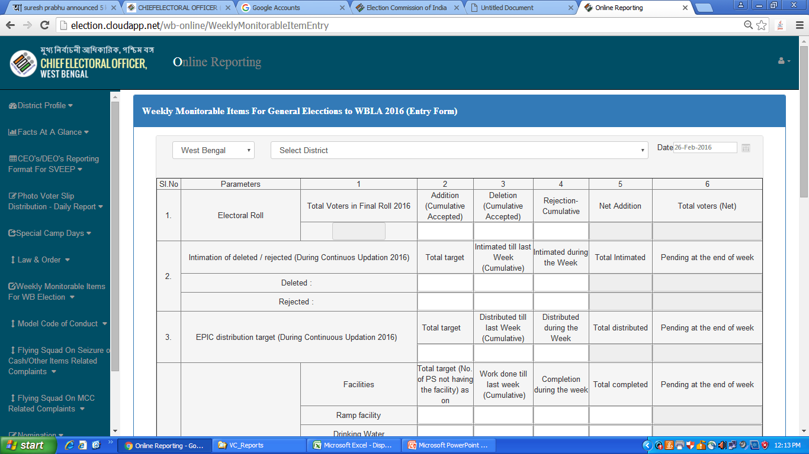

Slide 38
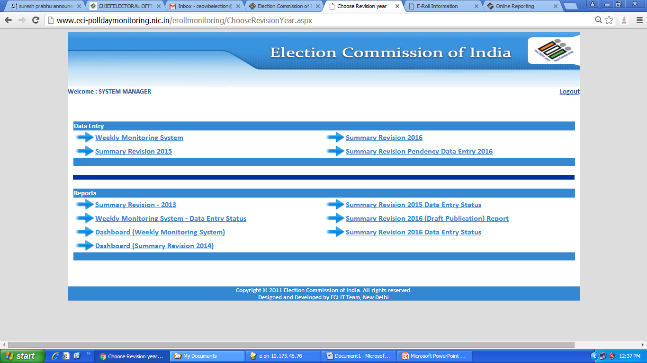
Election Commission of India - CEO’s Portal

Slide 39
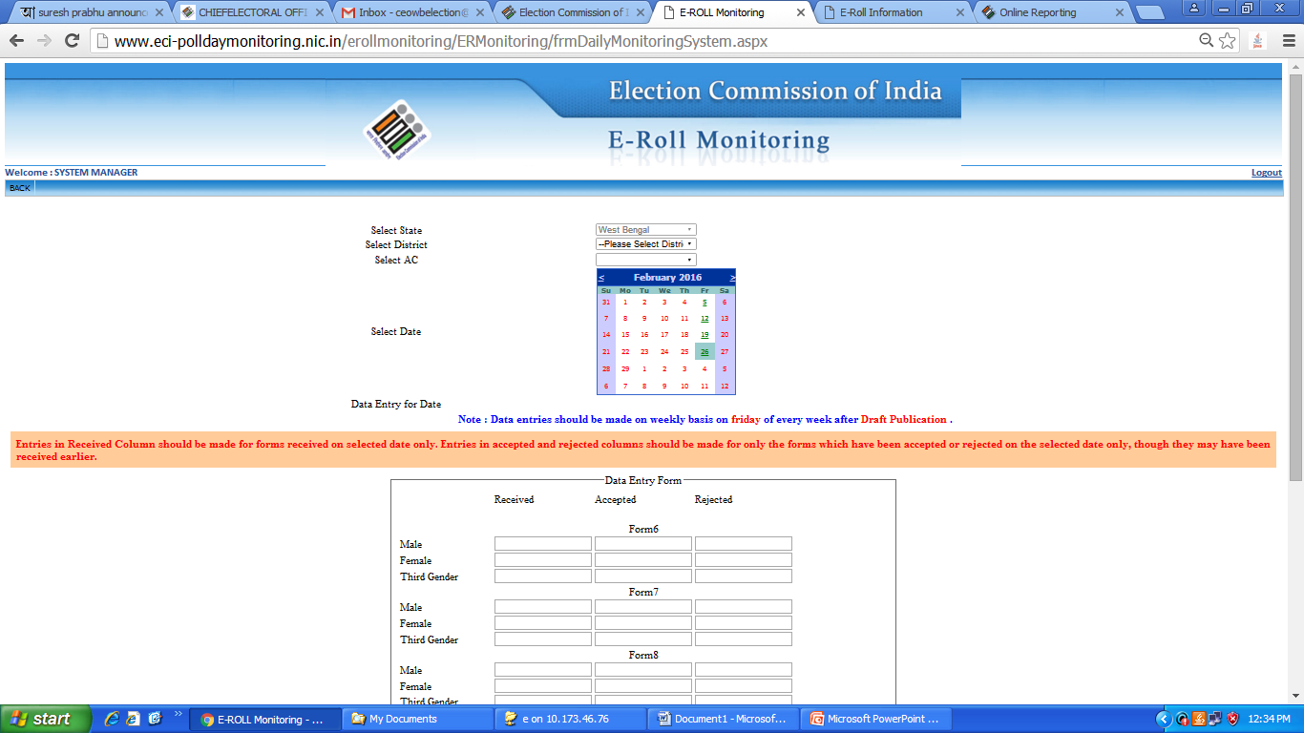

Slide 40
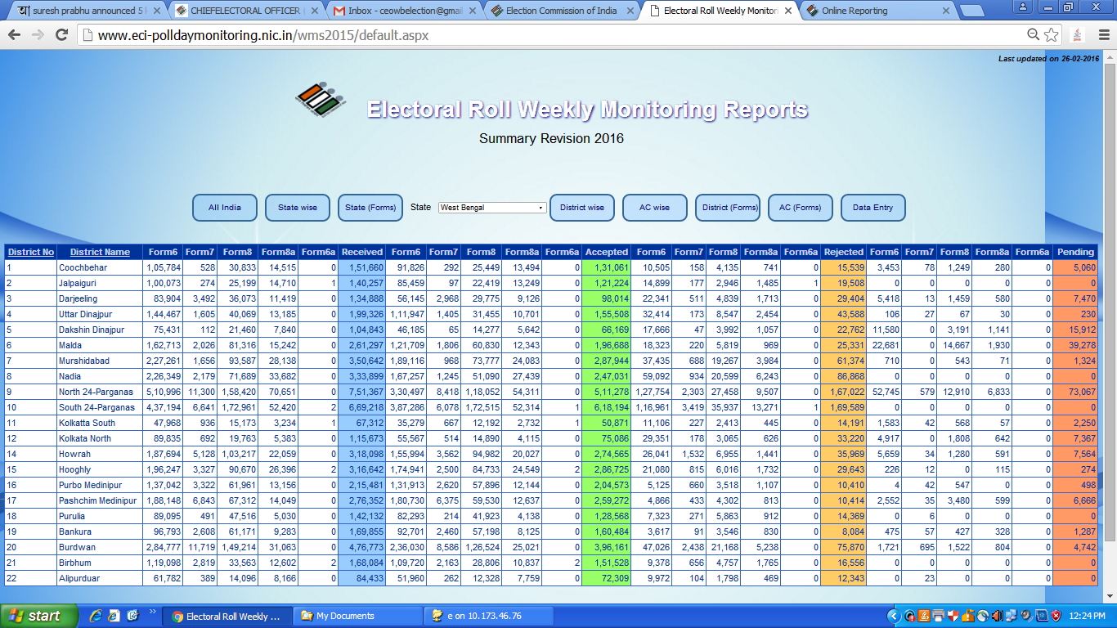
Electoral Roll Weekly Monitoring Dashboard

Slide 41
Thank You

